Slide 1
Inclusive hiring
Andrew Smith, Labour Market Facilitator

Slide 2
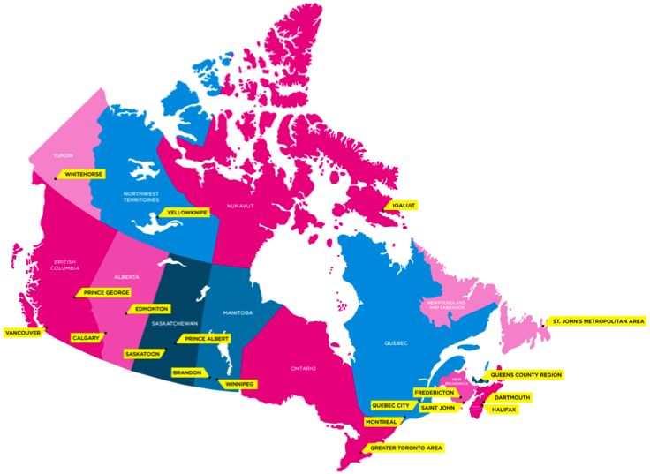
WHO WE ARE
Funded by the Government of Canada, we strive to increase the labour force participation of people with an intellectual disability or Autism Spectrum Disorder (ASD).
Active in 30 communities across the country, we have helped Canadian business hire over 3,000 positions.

Slide 4
in detail…
Bring to employers the business case of hiring a person with an intellectual disability/Autism Spectrum Disorder and connect existing vacancies to a talent pool of people through a network of agency partners.
Promote the principle of equal pay for equal work. No wage subsidies. No charity. All hiring on merit. Existing and open positions on the org chart only.
Highlight evidence that shows that people hired through RWA perform ‘as good if not better’ than existing employees on safety, reliability, attendance, punctuality, attitude, sick days and retention.
Highlight the PR/CR benefits - 87% of people prefer to give their business to organizations that hire inclusively.
Build capacity in employers so that inclusive hiring becomes a part of ongoing operations.

Slide 5
NATIONAL EMPLOYER PARTNERSHIPS

Slide 6
WHAT WE ASK of Employers
Recognize through the evidence of the business case that inclusive hiring is one of the best ways to show your community that you are invested in your community.
Make the commitment to hire inclusively (only if presented with a good fit, no different to any other hire).
Understand that the common barrier for this population is not the work itself, but getting past traditional employer hiring practices and misconceptions (interviewing instead of screening is key).
Be open to the fact that some people might need a bit of help upfront and before the hire is made (lots of support on that).
To work with us as a partner. Employers don’t get shown how to be inclusive.

Slide 7
Q & A

